Slide 1

Testing scientific code Because you’re worth it
Pietro Berkes and Lisa Schwetlick

Slide 2

You, as the Master of Research
You start a new project and identify a number of possible leads.
You quickly develop a prototype of the most promising ones; once a prototype is finished, you can confidently decide whether it is is a dead end, or worth pursuing.
Once you find an idea on which it is worth spending energy, you take the prototype and easily re-organize and optimize it so that it scales up to the full size of your problem.
As expected, the scaled-up experiment delivers good results, and your next paper is under way.

Slide 3
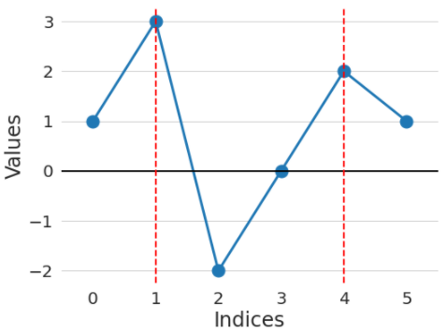
Warm-up project
Go to the directory called hands_on/local_maxima
In the file called local_maxima.py, write a function find_maxima that finds the indices of local maxima in a list of numbers
For example, find_maxima([1, 3, -2, 0, 2, 1]) should return [1, 4]

Slide 4
Warm-up project
Write a function find_maxima that finds the indices of local maxima in a list of numbers
Check your solution with these inputs:
Input: [1, 3, -2, 0, 2, 1] Expected result: [1, 4]
Input: [4, 2, 1, 3, 1, 5] Expected result: [0, 3, 5]
Input: [] Expected result: []
Input: [1, 2, 2, 1] Expected result: [1] (or [2], or [1, 2])
Input: [1, 2, 2, 3, 1] Expected result: [3]

Slide 5

Testing basics

Slide 6
A test is just another function
Imagine we wrote this new function, and we wanted to test it
def times_3(x):
"""Multiply x by 3.
Parameters
----------
x : The item to multiply by 3.
"""
return x * 3
Notes:
Hands on
1. test manually: it works if the function is very simple, but as you add more functions, or there are many things you need to test, then you will only test the last one and the rest can easily break
2. with if result != expected: raise Exception, with if __name__ == ‘__main__
3. better, but there we want to automatize! that’s pytest
4. try running tests with me (also show if there’s an error)

Slide 7
Testing frameworks
The collection of tests written to test a package is called a “test suite”
Execution of a test suite is automated: external software runs the tests and provides reports and statistics
Main testing frameworks for python:
unittest: in the standard library
pytest: what is most commonly used
=============================================== test session starts ================================================
platform darwin -- Python 3.11.3, pytest-7.3.1, pluggy-1.0.0
collected 2 items
test_first.py::test_times_3_integer PASSED [ 50%]
test_first.py::test_times_3_string PASSED [100%]
================================================ 2 passed in 0.00s =================================================

Slide 8
Hands-on!
Go to hands_on/first
Discover all tests in all subdirectories pytest -v
Execute all tests in one module pytest -v test_first.py
Execute one single test pytest -v test_first.py::test_times_3_string

Slide 9
Test suites in Python with pytest
Writing tests with pytest is simple:
Tests are collected in files called test_abc.py , which usually contains tests for the functions defined in a corresponding module abc
Each test is a function called test_jkl_feature, and usually it tests feature feature of a function called jkl
Each test tests one feature in your code, and checks that it behaves correctly using “assertions”. An exception is raised if it does not work as expected.

Slide 10
Basic structure of test
A good test is divided in three parts:
Given: Put your system in the right state for testing
Create data, initialize parameters, define constants…
When: Execute the feature that you are testing
Typically, one or two lines of code
Then: Compare outcomes with the expected ones
Define the expected result of the test
Set of assertions that check that the new state of your system matches your expectations

Slide 11
Assertions
assert statements check that some condition is met, and raise an exception otherwise
Check that statement is true/false: assert 'Hi'.islower() => fail assert not 'Hi'.islower() => pass
Check that two objects are equal: assert 2 + 1 == 3 => pass assert [2] + [1] == [2, 1] => pass assert 'a' + 'b' != 'ab' => fail
assert can be used to compare all sorts of objects, and pytest will take care of producing an appropriate error message

Slide 12
What a good test looks like
What does a good test look like? What should I test?
Good:
Short and quick to execute
Easy to read
Tests one thing
Bad:
Relies on data files
Messes with “real-life” files, servers, databases
Notes:
We saw how to test, but what is a good test? and what should we test?

Slide 13
Write a working version of find_maxima, with testing
Read carefully the description of Issue #1 on GitHub
Submit a Pull Request for Issue #1
Fork the repository (if you haven’t already)
Create a new branch on the fork called, e.g., fix-1
Solve the issue with one or more commits
Push the branch to your GitHub fork
On GitHub, go to “Pull Requests” and open a pull request against branch main of the official ASPP repository
In the PR description write “Fixes #1” somewhere, this is going to create an automatic link to the issue, and close the issue if the PR is merged

Slide 14

Testing is good for your self-esteem
Immediately: Always be confident that your results are correct, whether your approach works of not
In the future: save your future self some trouble!
If you are left thinking “it’s cool but I cannot test my code because XYZ”, talk to us and we’ll show you how to do it ;-)
You, in 2024
You, in 2025

Slide 15

Testing patterns

Slide 16
Floating point equality
Real numbers are represented approximately as “floating point” numbers. When developing numerical code, we have to allow for approximation errors.
Check that two numbers are approximately equal: from math import isclose def test_floating_point_math(): assert isclose(1.1 + 2.2, 3.3) => pass
abs_tol controls the absolute tolerance: assert isclose(1.121, 1.2, abs_tol=0.1) => pass assert isclose(1.121, 1.2, abs_tol=0.01) => fail
rel_tol controls the relative tolerance: assert isclose(120.1, 121.4, rel_tol=0.1) => pass assert isclose(120.4, 121.4, rel_tol=0.01) => fail
Notes:
If you’re working with floating point numbers two number are rarely exactly the same

Slide 17
Testing with numpy arrays
def test_numpy_equality(): x = np.array([1, 1]) y = np.array([2, 2]) z = np.array([3, 3]) assert x + y == z
__________________________________ test_numpy_equality __________________________________
def test_numpy_equality():
x = numpy.array([1, 1])
y = numpy.array([2, 2])
z = numpy.array([3, 3])
> assert x + y == z
E ValueError: The truth value of an array with more than one element is ambiguous. Use a.any() or a.all()
code.py:47: ValueError
Notes:
The intention was to test for equality element-by-element

Slide 18
Testing with numpy arrays
The module np.testing defines helper functions: assert_equal(x, y) assert_allclose(x, y, rtol=1e-07, atol=0)
If you need to check more complex conditions:
np.all(x): returns True if all elements of x are true np.any(x): returns True is any of the elements of x is true
combine with logical_and, logical_or, logical_not: # test that all elements of x are between 0 and 1 assert all(logical_and(x > 0.0, x < 1.0))
Notes:
The right way to do this is using …
If you need to check more complex conditions
allclose:
The tolerance values are positive, typically very small numbers. The
relative difference (`rtol` * abs(`b`)) and the absolute difference
`atol` are added together to compare against the absolute difference
between `a` and `b`.

Slide 19
Watch out for nans!
In general, nan is not equal to itself (IEEE standard)
assert_equal and assert_allclose consider nans equal by default
In [2]: np.nan == np.nan
Out[2]: False
def test_allclose_with_nan():
x = np.array([1.1, np.nan])
y = np.array([2.2, np.nan])
z = np.array([3.3, np.nan])
assert_allclose(x + y, z)
test_numpy_equality.py::test_allclose_with_nan PASSED

Slide 20
Common for-loop pattern for testing multiple cases
Often these cases are collected in a single test:
def test_lower(): # Given # Each test case is a tuple of (input, expected_result) test_cases = [('HeLlO wOrld', 'hello world'), ('hi', 'hi'), ('123 ([?', '123 ([?'), ('', '')] for string, expected in test_cases: # When output = string.lower() # Then assert output == expected

Slide 21
The for-loop pattern can be improved
It is repetitive to write the for-loop pattern
If one of the cases break, it can be complicated to figure out which one
pytest has many helpers for simplifying common testing cases!
One of them is the parametrize decorator, that simplifies running the same test with multiple cases

Slide 22
Simple example
def test_for_loop_simple(): cases = [1, 2, 3] for a in cases: assert a > 0
test_for_loop_simple runs once and loops over 3 test cases

Slide 23
Simple example, with the parametrize decorator
Name of the variable that varies
List of values for the variable
test_parametrize_simple runs 3 times with a=1, a=2, and a=3
@pytest.mark.parametrize('a', [1, 2, 3]) def test_parametrize_simple(a): assert a > 0
The test must take an argument with the same name
Notes:
Remember to import pytest!

Slide 24
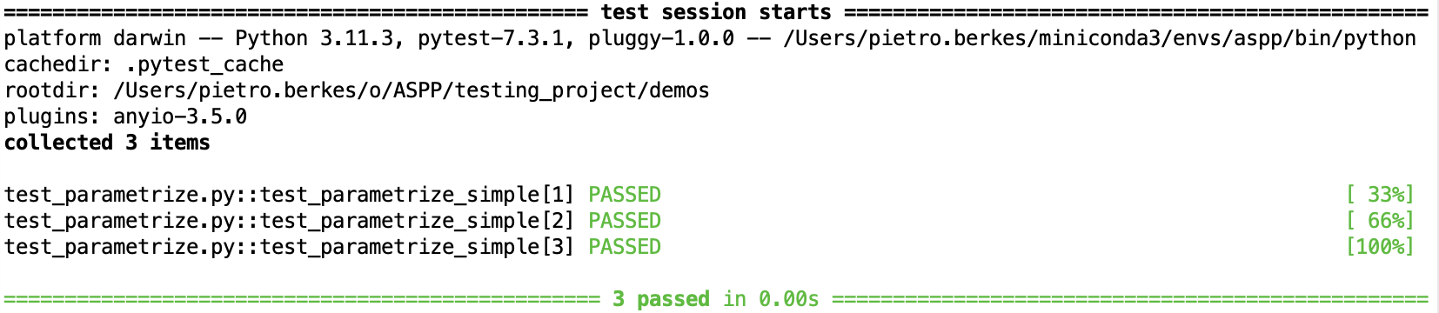
Simple example, with the parametrize decorator
Name of the variable that varies
List of values for the variable
@pytest.mark.parametrize('a', [1, 2, 3]) def test_parametrize_simple(a): assert a > 0
The test must take an argument with the same name
pytest automatically creates one separate test for each test case

Slide 25
Example with multiple values
This is a more typical case with several input values and the expected result of the test
def test_for_loop_multiple(): cases = [
(1, 'hi', 'hi’),
(2, 'no', 'nono’)
] for a, b, expected in cases: result = b * a assert result == expected
test_for_loop_multiple runs once and loops over 2 test cases

Slide 26
Same example, with the parametrize decorator
Name of all the variables, separated by commas in one string
List of tuples with the values for each varialbe, one for each test case
@pytest.mark.parametrize('a, b, expected', [(1, 'hi', 'hi'), (2, 'no', 'nono')]) def test_parametrize_multiple(a, b, expected): result = b * a assert result == expected
The test must take arguments with the same names as in the string
test_parametrize_multiple runs 2 times with 1) a=1 b=‘hi’ expected=‘hi’
and
2) a=2 b=‘no’, expected=‘nono’

Slide 27
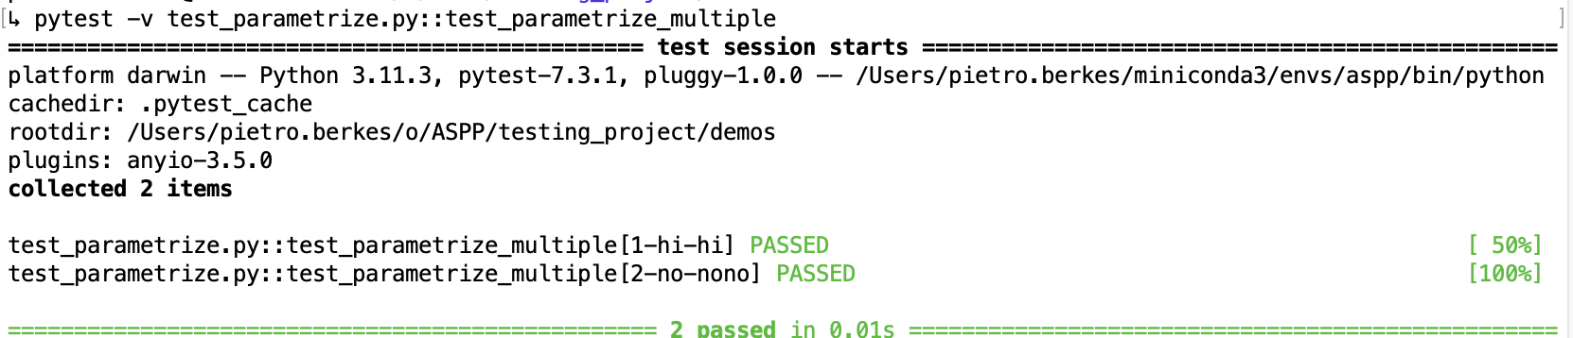
Same example, with the parametrize decorator
Name of all the variables, separated by commas in one string
List of tuples with the values for each varialbe, one for each test case
@pytest.mark.parametrize('a, b, expected', [(1, 'hi', 'hi'), (2, 'no', 'nono')]) def test_parametrize_multiple(a, b, expected): result = b * a assert result == expected
The test must take arguments with the same names as in the string
pytest automatically creates one separate test for each test case

Slide 28
Strategies for testing learning algorithms
Learning algorithms can get stuck in local maxima, the solution for general cases might not be known (e.g., unsupervised learning)
Turn your validation cases into tests
Stability tests:
Start from final solution; verify that the algorithm stays there
Start from solution and add a small amount of noise to the parameters; verify that the algorithm converges back to the solution
Parameter Recovery: Generate synthetic data from the model with known parameters, then test that the code can learn the parameters back
Notes:
…
There is no general rule for testing these algorithm, for each specific algorithm there are usually validation cases (e.g, a classifier might be validated using two classes of very different objects)

Slide 29
Learning algorithms fit the parameters of a model to observed data
y = ax + b + noise
a = -1.2
b = 3

Slide 30
Generate synthetic data from the model to test the learning algorithm by recovering the parameters
1) Fix initial parameters
a* = 0.5
b* = -1.3

Slide 31
Generate synthetic data from the model to test the learning algorithm by recovering the parameters
1) Fix initial parameters
2) Generate synthetic data
y = a* x + b* + noise
a* = 0.5
b* = -1.3

Slide 32
Generate synthetic data from the model to test the learning algorithm by recovering the parameters
1) Fix initial parameters
2) Generate synthetic data
y = a* x + b* + noise
a* = 0.5
b* = -1.3
3) Run the algorithm
a = 0.5098
b = -1.287
y = ax + b + noise

Slide 33
Generate synthetic data from the model to test the learning algorithm by recovering the parameters
1) Fix initial parameters
2) Generate synthetic data
y = a* x + b* + noise
a* = 0.5
b* = -1.3
4) Compare
3) Run the algorithm
a = 0.5098
b = -1.287
y = ax + b + noise

Slide 34

Randomness in Testing
Using randomness in testing can be useful
To check that the code is stable and works correctly in many different cases
To find corner cases or numerical problems
def test_logistic_fit_randomized():
random_state = np.random.RandomState(SEED)
for _ in range(100):
x0 = random_state.uniform(0.0001, 0.9999)
r = round(random_state.uniform(0.001, 3.999), 3)
xs = iterate_f(it=17, x0=x0, r=r)
recovered_r = fit_r(xs)
assert_allclose(r, recovered_r, atol=1e-3)
Notes:
numpy.random.RandomState!
random_state = np.random.RandomState(SEED)
random_state.rand()
otherwise using the global seed, if any external library uses np.random it can screw up the determinism

Slide 35
Random Seeds and Reproducibility
When running tests that involve radomness and some test doesn’t pass it is vital to be able to reproduce that test exactly!
Computers produce pseudo-random numbers: setting a seed resets the basis for the random number generator
This is essential for reproducibility
At a minimum, you should manually set the seed for each of your random tests
SEED = 42
random_state = np.random.RandomState(SEED)
random_state.rand()
Notes:
numpy.random.RandomState!
random_state = np.random.RandomState(SEED)
random_state.rand()
otherwise using the global seed, if any external library uses np.random it can screw up the determinism

Slide 36
A Pytest Solution
Non-scientific coding uses random testing more rarely, so there is no helper tools for that in pytest
However, in scientific coding it is quite common
What do we want?
For each (random) test there should be a seed
For each run of the test, the seed should be different
That seed should be printed with the test result
It needs to be possible to explicitely run the test again with that seed!

Slide 37
Fixtures (minimal solution)
Fixtures are functions that are run before the tests are executed
import numpy as np
import pytest
# set the random seed for once here
SEED = np.random.randint(0, 2**31)
@pytest.fixture
def random_state():
print(f'Using seed {SEED}')
random_state = np.random.RandomState(SEED)
return random_state
def test_something(random_state): random_state.rand()
If an input argument of a test matches the name of a fixture, then the fixture is called and the return value assigned to the argument.
pytest handles that automatically as part of running the test suite
Notes:
If you want it to make a random seed for the whole module instead fo for every test, use “scope=‘module’”

Slide 38

Hands On!
Write a randomized test that checks that fit_r can recover r for any random value of x0 and r
Add a fixture at the top of your test file, that lets you print the seed to the console.

Slide 39
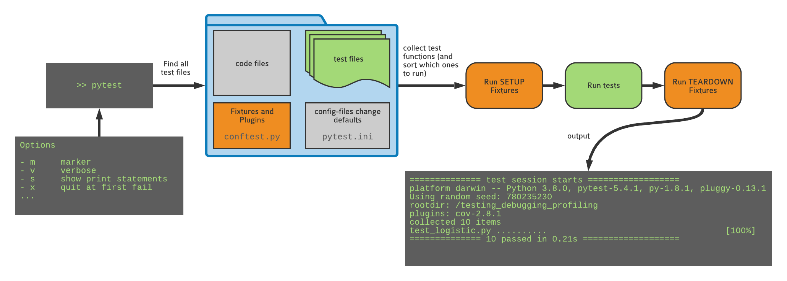
What happens when you run pytest

Slide 40

Fixtures (real solution)
conftest.py is a special pytest config file (don’t import it!)
conftest.py can be used to define custom behavior or plugins. Fixtures can also be defined here, so that they can be used by all tests.
See the file hands_on/randomness/_conftest.py in the repo you forked. If you move it to the main folder and rename it, the functions defined there select a seed for each test and allow you to pass a seed on the command line using --seed 123

Slide 41
Decorating “special” tests
@xfail: Expected failure, outputs an “x” (or “X”) in the report
@skip: Skip test, useful e.g. when the feature doesn’t exist yet
@skipif: Skip the test if a condition is met, useful for tests that only works on a specific platform, or for a specific version of Python
@pytest.mark.xfail
def test_something():
...
@pytest.mark.skip(reason=“functionality not yet implemented”)
def test_something():
...
@pytest.mark.skipif(sys.version_info < (3, 10), reason="requires python3.10 or higher")
def test_something():
...

Slide 42
Marking tests with custom markers
If you have lots of tests, you can categorize them with your own markers
although for custom mark names you need to register the marks “pytest.ini”
https://docs.pytest.org/en/7.1.x/example/markers.html#registering-markers
Example:
Smoke tests check for really basic features: run these frequently
Other tests may be many or too slow to run every time and test for more edge cases
@pytest.mark.smoke
def test_something_basic():
...
> pytest –m smoke
> pytest –m ”smoke and not slow”

Slide 43
Writing temporary files: tmp_path
To test functions that write to disk without leaving around the files when the test is finished, use the tmp_path fixture
The value of tmp_path is a pathlib.Path object
The directory is created at the start of the test, and removed at the end
def test_create_file(tmp_path):
d = tmp_path / "sub"
d.mkdir()
p = d / "hello.txt"
content = "some random text"
p.write_text(content)
assert p.read_text() == content
assert len(list(tmp_path.iterdir())) == 1
All you need to do is add an argument with this exact name

